Slide 1
Deduplicator
Jiaxin Tang, Ganquan Wen, Xiang Zheng, Zulin Liu, Zisen Zhou
Github link: https://github.com/GanquanWen/Deduplicator

Slide 2
Project Overview
A data storage locker that utilizes deduplication. The locker is able to receive files and store them (for later retrieval) with a minimum storage by storing some common data blocks only once.
For example, a first file containing "This is an example" might store all characters, but a second file containing "This is an example too" might store a pointer to the first file followed by " too".
In our project, we will test our program with ASCII and binary files, any two of which differ in at most 5 character edits (character edits are insertions of a character, deletion of a character, or modification of a character)

Slide 3
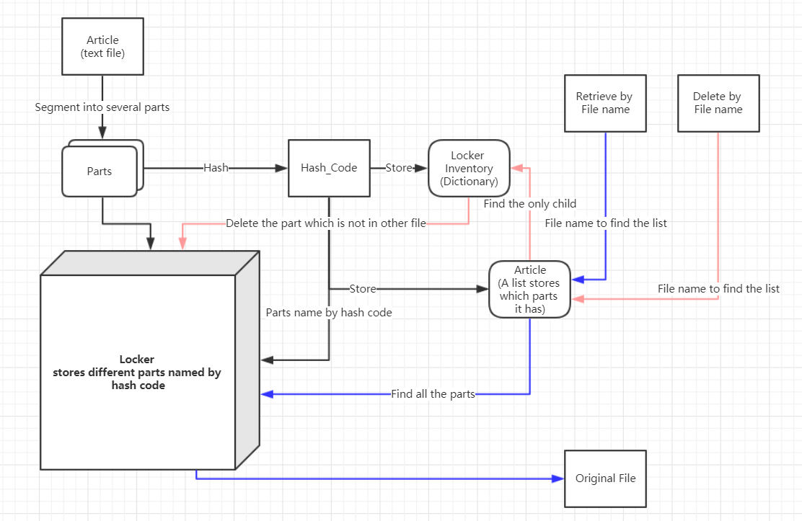
High level diagram

Slide 4
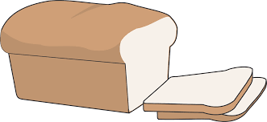
2 main different chunking methods
Fixed-size block chunking
Easy to implement
Good performance for character replacement
Has an issue when it comes to add and delete characters
Variable-size block chunking
The length of each block is different
Solves the issue deriving from fixed-size chunking
In our project: Variable-size block chunking
For ASCII file: paragraphs
For Binary file: predefined sign bits
Notes:
Xiang

Slide 5
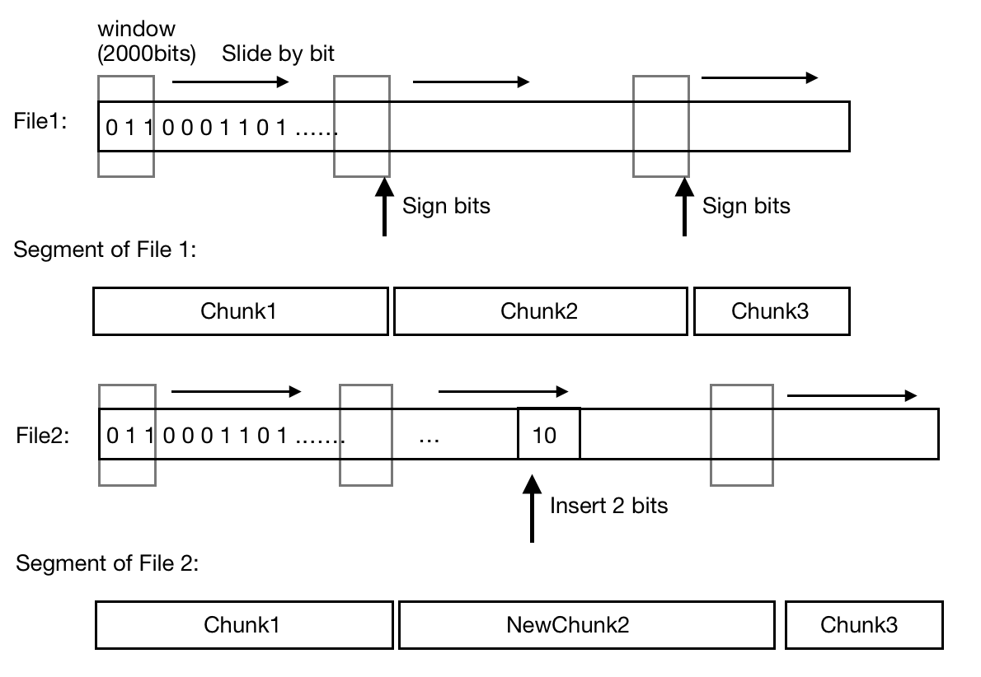
Main technique for binary file chunking
Hash algorithm (sha.256)
Sliding window
Set parameter of sliding window empirically
Window length: 2000
Predefined sign bits: 010101
Notes:
Xiang

Slide 6
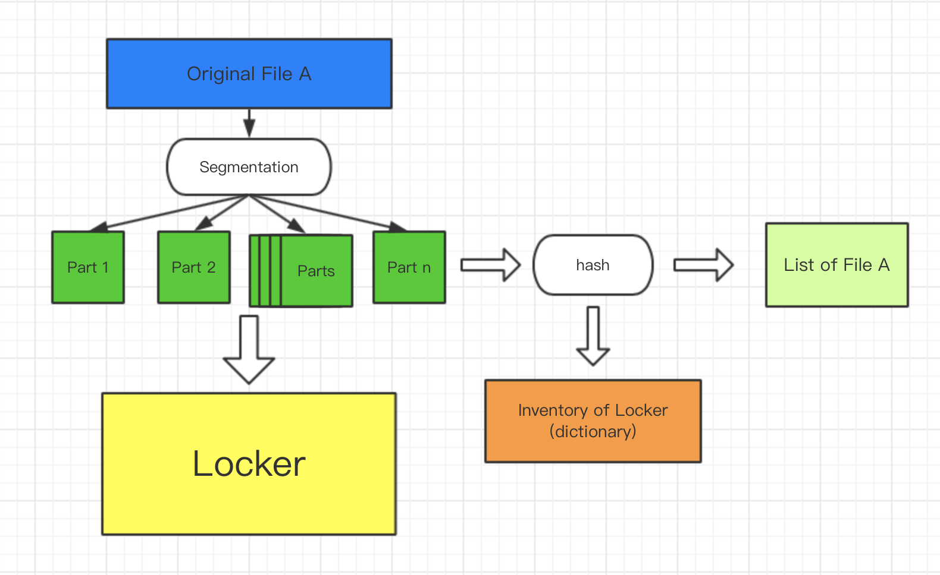
Storing diagram
Notes:
Xiang
If the hash value of part i is in Inventory, we don’t store it repeately.

Slide 7
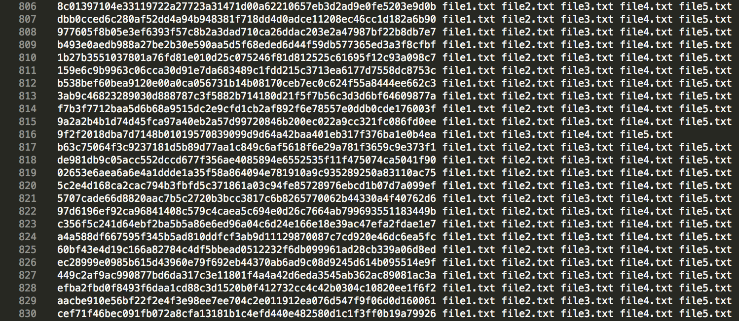
Inventory and Lists
Left: Name of each part Right: The files that contain this part
Notes:
Gan

Slide 8
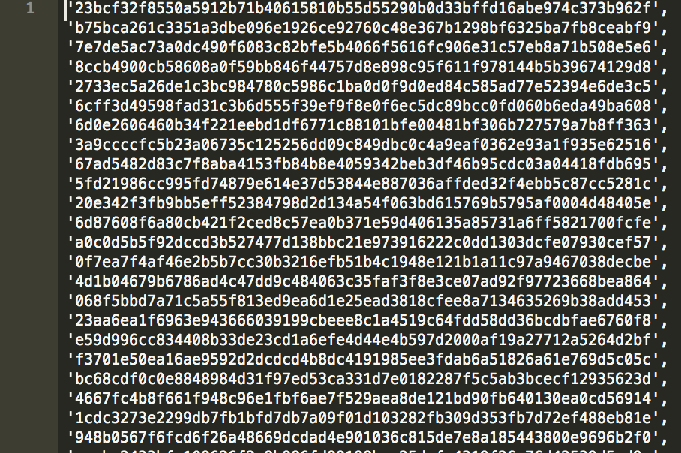
Inventory and Lists
The list of a file lists all parts that the file contains in order.
Notes:
Gan

Slide 9
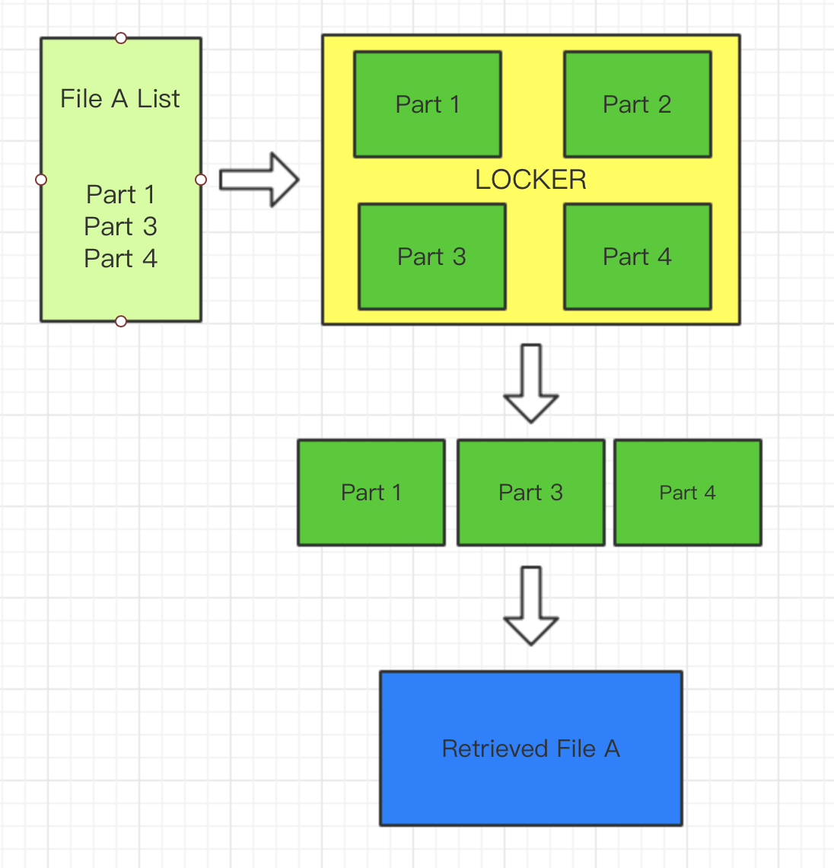
Retrieving
Picks all parts on list from the locker. And then connect all parts in order to retrieve the file.
Notes:
Gan

Slide 10
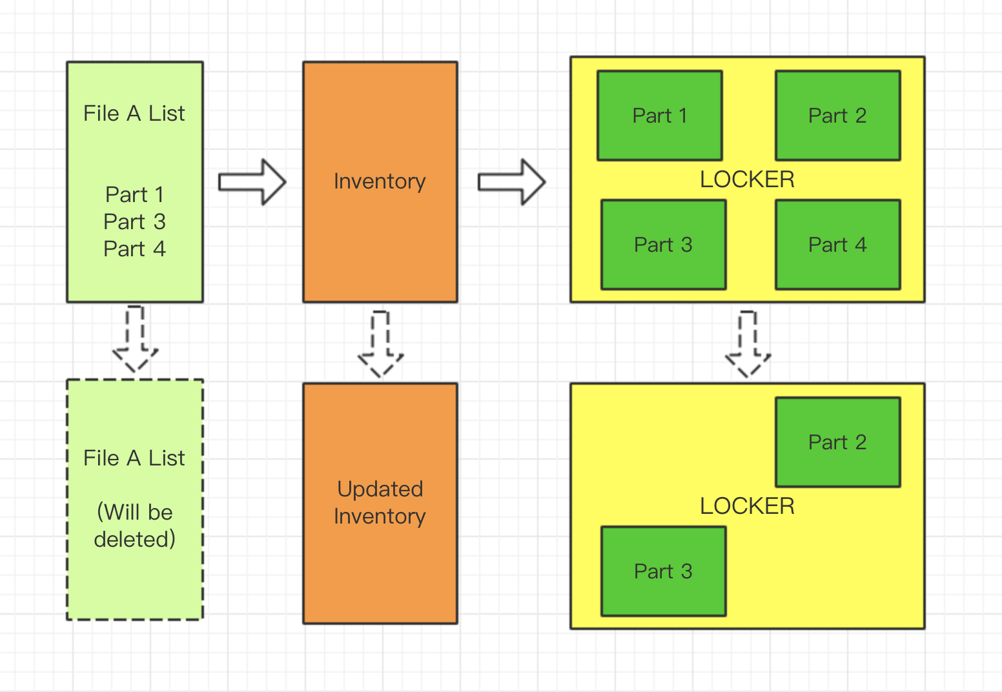
Deleting
Check the Inventory to see if the parts contained by the file can be deleted.
If a part is contained by multiple files, it can not be deleted.
If a part is contained only by the file, then this part can be deleted.
Part 3 is also in other files, so it would not be deleted.
Notes:
Gan

Slide 11
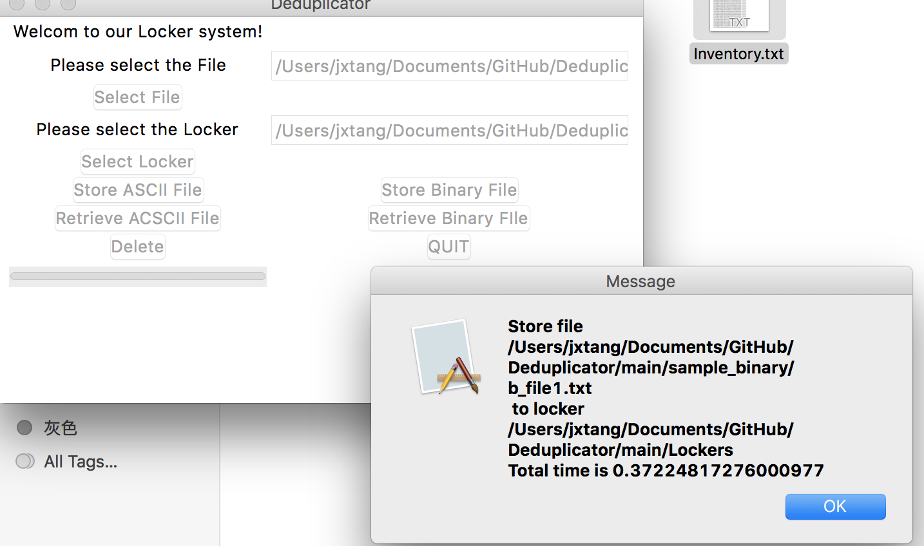
Graphical User Interface
Implement the graphical user interface by tkinter
File dialog to choose file and locker
Buttons for different functions
Progressbar from ttk for progressbar
Canvas to display the progress in percentage
Seperate thread for interface to speed up
Notes:
Zisen

Slide 12
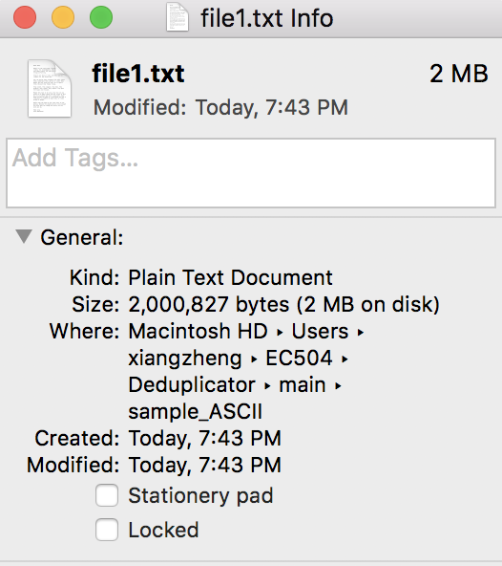
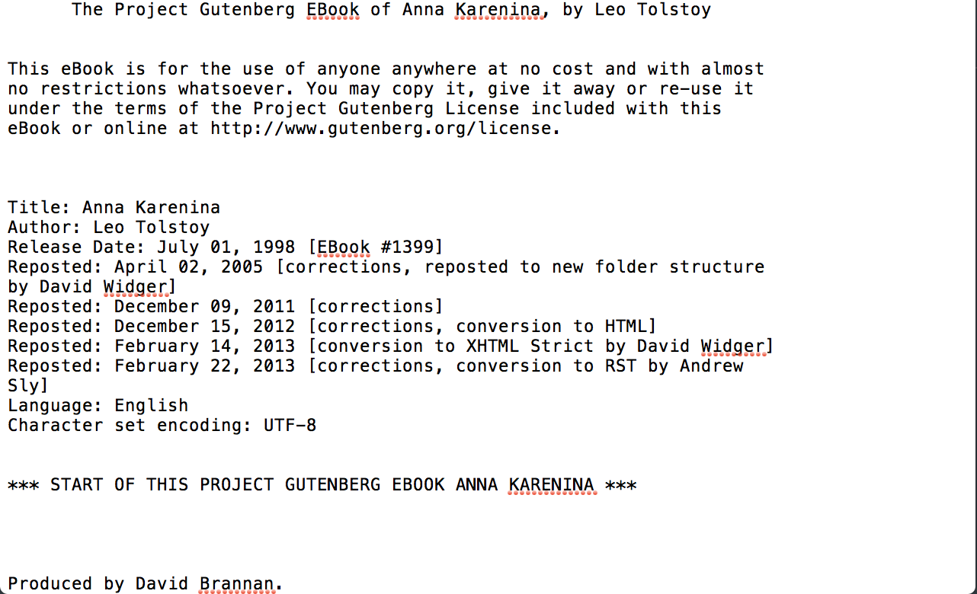
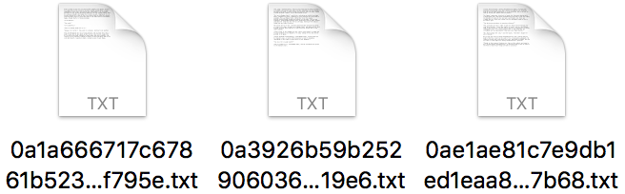
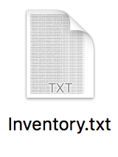
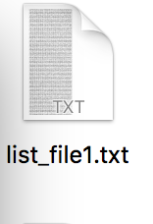
Test & Result
After store
…...
file1.txt

Slide 13
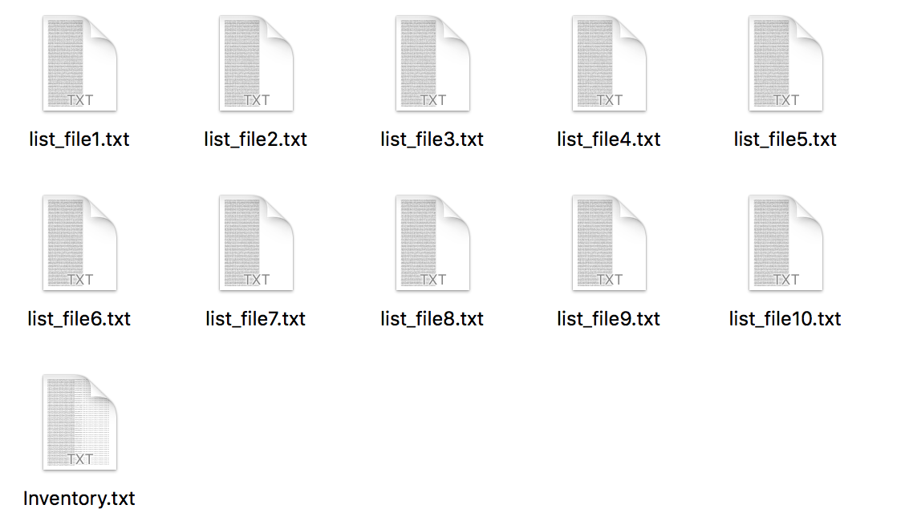
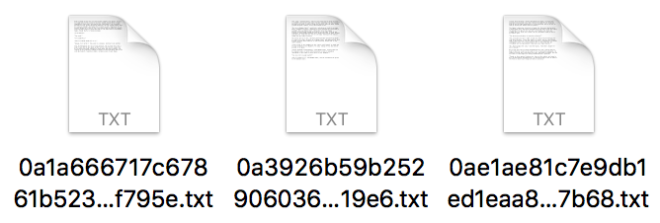
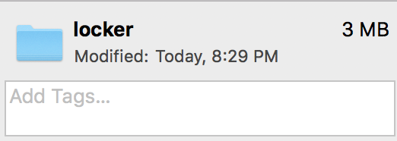
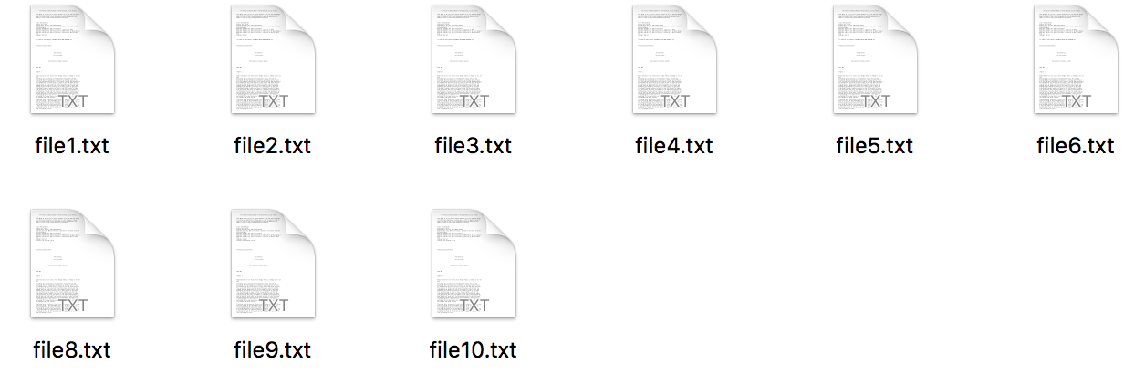
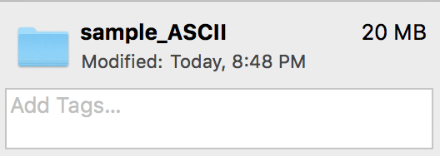
Test & Result
After store
…...
We store ten 2MB ASCII files using 3MB of storage.
20 MB ➡️ 3MB

Slide 14
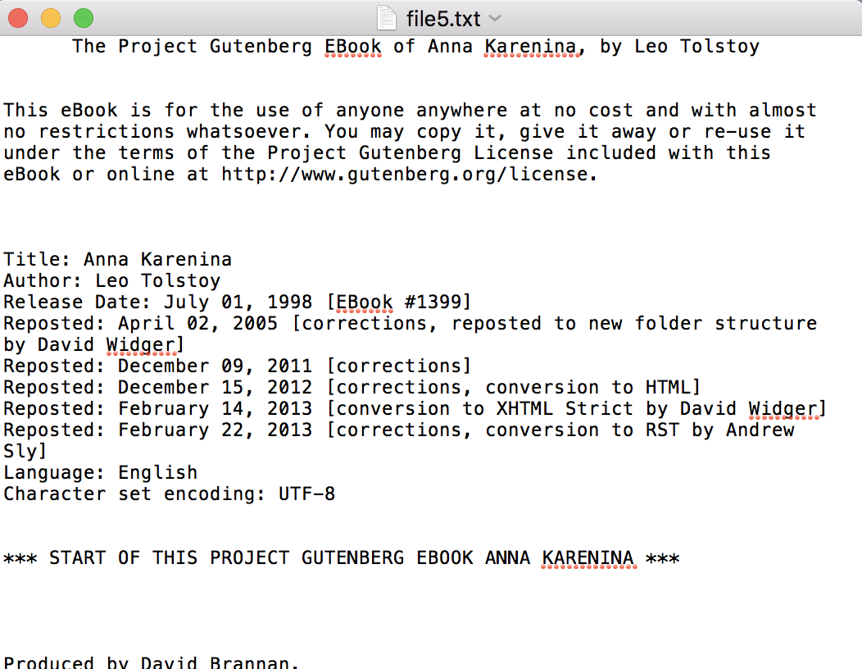
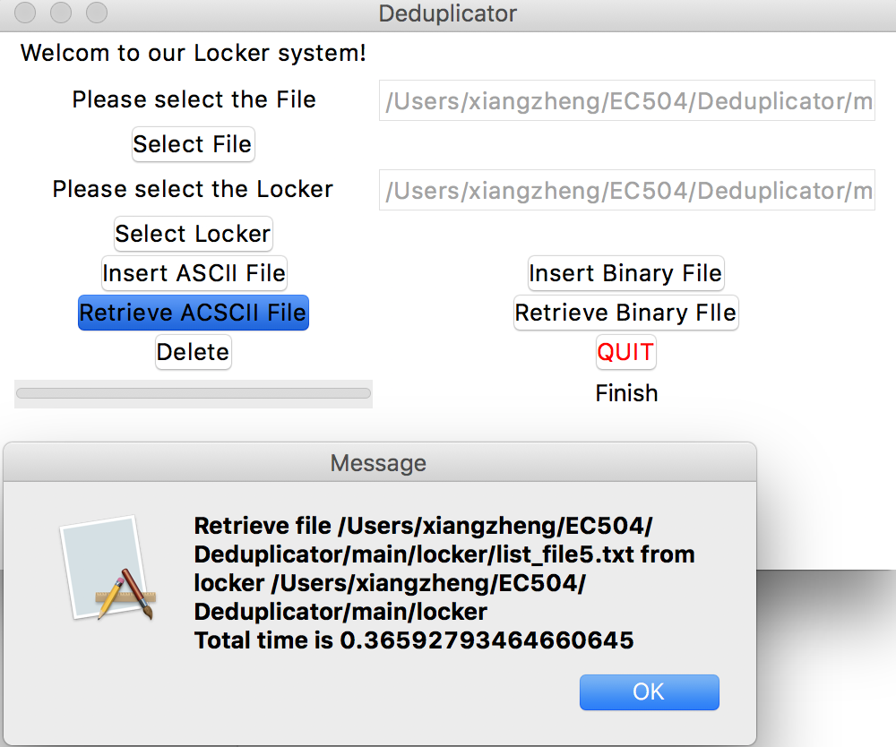
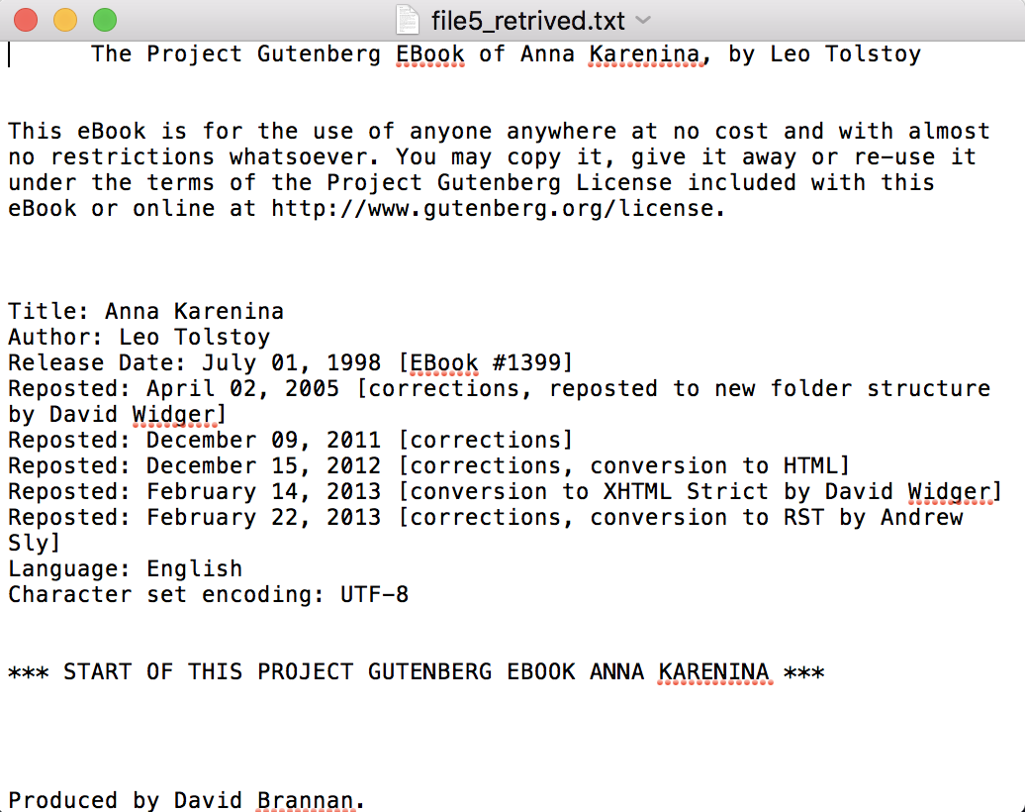
Test & Result

Slide 15
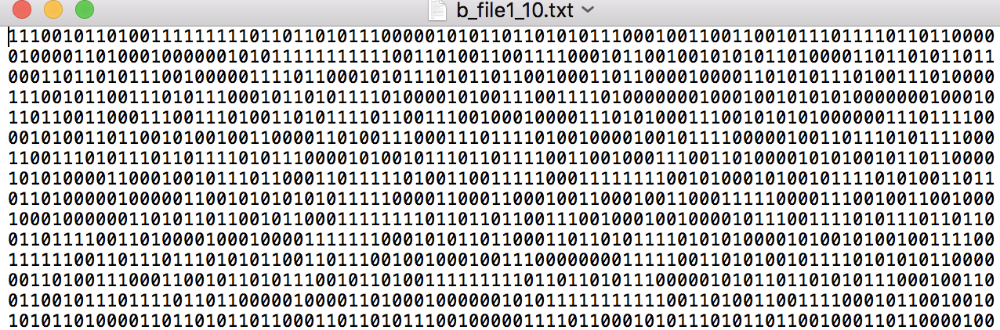
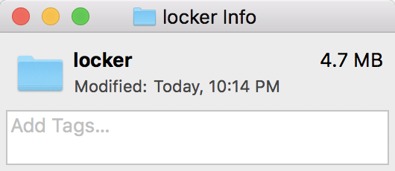
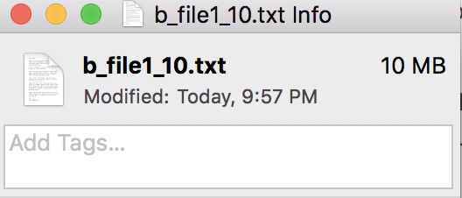
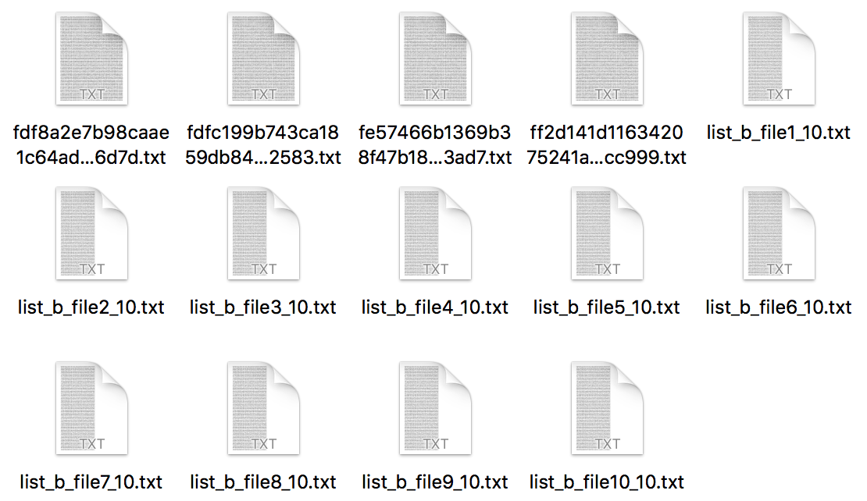
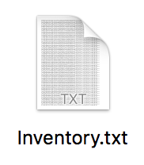
Test & Result (Binary file)
After store 10 of them

Slide 16
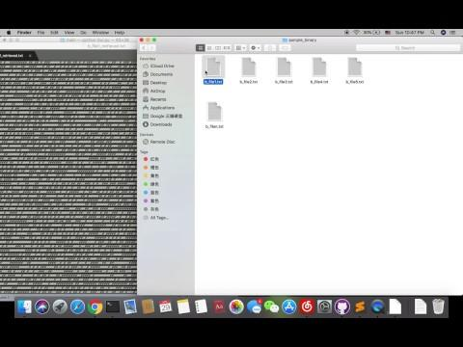
Video Demo
Notes:
Gan Jiaxin

Slide 17
Links & References
Data Deduplication for Data Optimization for Storage and Network Systems. Daehee Kim, Sejun Song, Baek-Young Choi
Study of Chunking Algorithm in Data Deduplication. A. Venish and K. Siva Sankar
A Study of Practical Deduplication. Dutch T. Meyer and William J. Bolosky
https://www.researchgate.net/publication/287251603_Study_of_Chunking_Algorithm_in_Data_Deduplication
http://python-textbok.readthedocs.io/en/1.0/Introduction_to_GUI_Programming.html

Slide 18
Thank you!!

